Slide 1
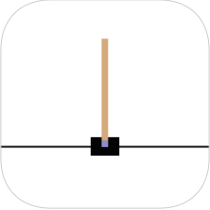
Building Cart Pole Game using RL
Workhardplayharder Team
Sun Yuan Lum, z5289055
Jiawei Deng, z5305322
Yaxin Yuan, z5366243
Tianwei Mo, z5305298
Zebin Chen, z5237137

Slide 2
Sections
01
04
The Cart Pole Game
Result
02
05
Project Introduction
Result Analysis
03
06
Methods
Conclusion

Slide 3
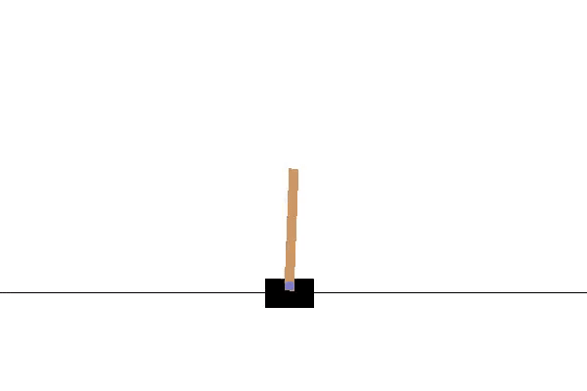
Introduction: Cart Pole game
Cart is attached to one end of the pole, initially upright
Cart can be either moved left or right
When the game starts, the pole will start to fall to the left or right
Keep the pole upright for as long as possible to attain maximum score
Game ends when either the cart reaches the left border or right border, or if the pole falls down

Slide 4
Introduction: learning Cart Pole game using Reinforcement Learning
Methods Used
Aims of this project
Why is this important?
REINFORCE method
Deep Q-Learning
Double Deep Q-Learning
Provide detailed documentation of implementing various reinforcement learning methods on Cart Pole game
Cultivates interest in reinforcement learning
Come up with innovative solutions to different problems
Reinforcement learning is being applied to biggest industries in the world, rapidly expanding

Slide 5
Methods
Reinforce
Deep Q-Learning
Double Deep Q-Learning
Advantages
Advantages
Advantages
Learning strategies from the optimal distribution of functions
Introduction of experience replay and target network mechanisms
Improved training efficiency
The agent uses two neural networks to learn and predict the actions to be taken at each step
More stable and more efficient than DQN
Disadvantages
Disadvantages
Takes a long time
Unsatisfactory results
Overestimate the reward
Low quality strategies

Slide 6
Training Environment
Classification
A game in the
Reinforcement Learning environment, no dataset needed
CartPole
Chosen Environment
The CartPole environment in OpenAI gym

Slide 7
Features of the Training Environment
Initial State
Call env.reset() at the start of each episode
1. Pole Angle is greater than ±12°
2. Cart Position is greater than ±2.4 (centre of the cart reaches the edge of the display)
3. Episode length is greater than 500 for CartPole_v1, 200 for CartPole_v0.
Gym CartPole environment
Terminal State
Episode
The time duration between the initial state and terminal state
Make use of env.step()
Pass in the action determined by the policy to env.step(action), it will perform the action and return information related to the status of CartPole
Action and Status

Slide 8
Hyperparameters
01 | max_epsilon | Maximum exploration rate
02 | min_epsilon | Minimum exploration rate
03 | epsilon_decay | Decay rate of epsilon
04 | batch_size | Size of the sample batch taken from the experience buffer
05 | replay_capacity | Size of the experience buffer
06 | lr | Learning rate
07 | gamma | Discount factor

Slide 9
Hyperparameters
01 | hid | Number of hidden nodes for each hidden layer
02 | num_episodes | Total number of episodes for each training run
03 | avg_steps | Average steps
04 | continue_reward | Reward given to agent when the game continues running
05 | fail_reward | Reward given to agent when the game fails
06 | target_update | Specifies the time interval of updating the target network
07 | epoch | Specifies the episode interval of output printing

Slide 10
Hyperparameter: Greedy Epsilon
Minimum epsilon Performance
1e-2 | Good
5e-3 | Good
1e-3 | Good
0 | Good
5e-2 | Good
0.1 | Acceptable
0.5 | Bad

Slide 11
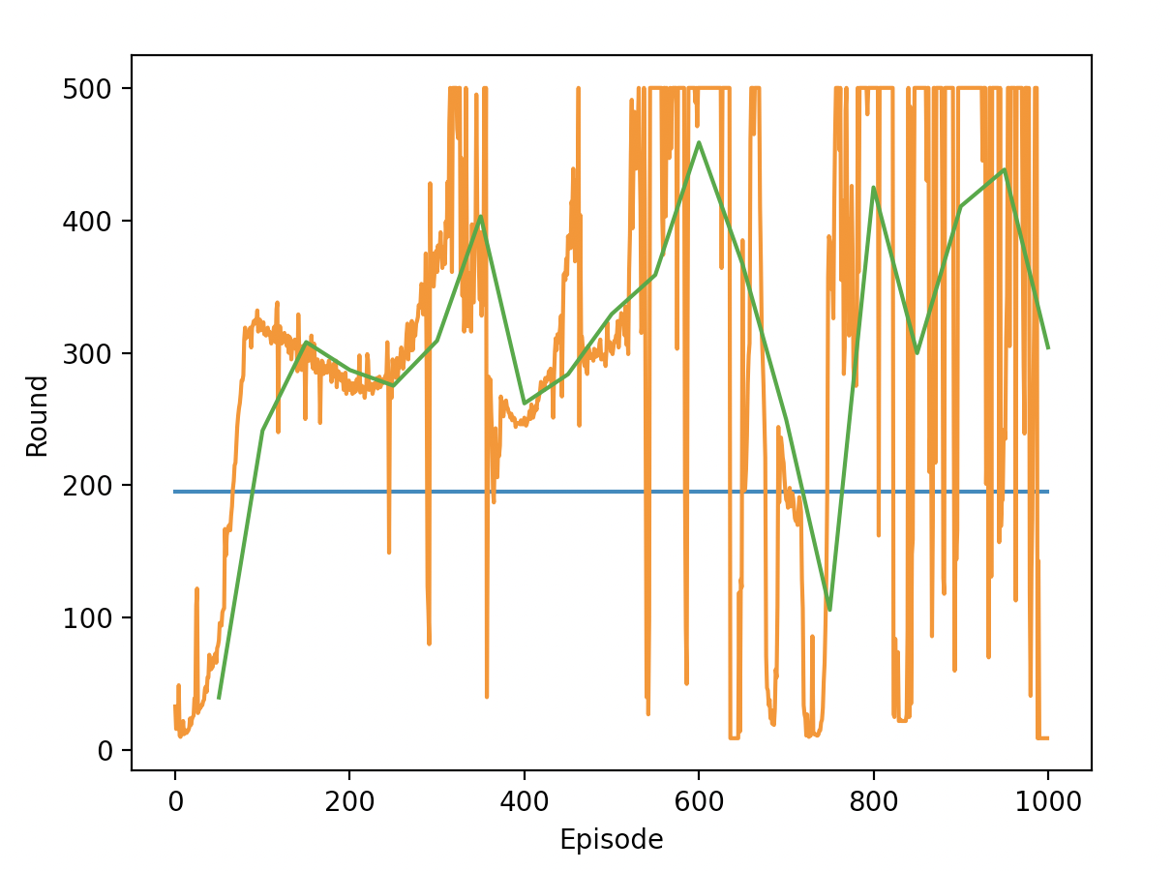
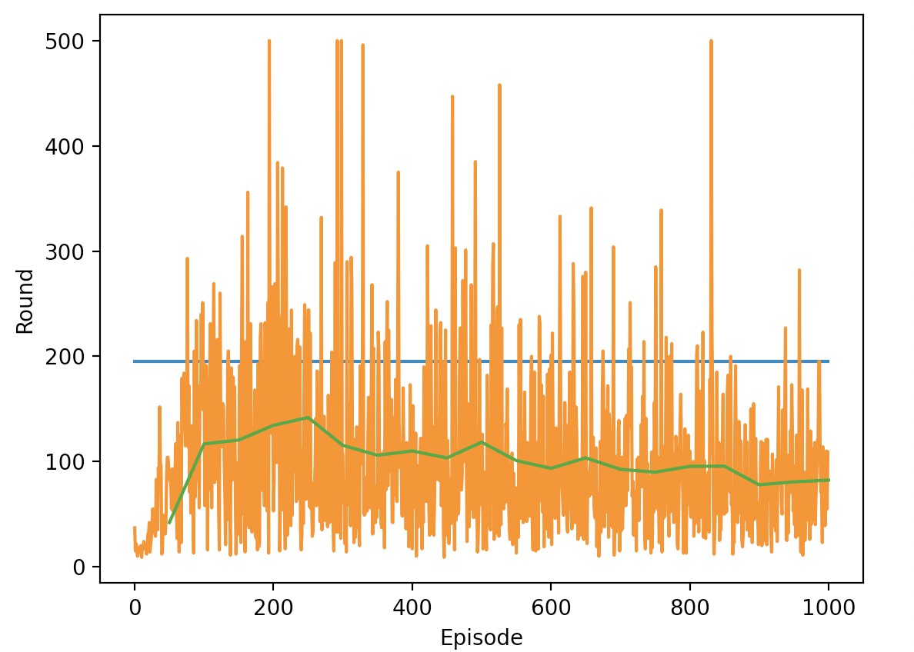
Hyperparameter: Greedy Epsilon
Minimum epsilon: 5e-3 (Good)
Minimum epsilon: 0.5 (Bad)

Slide 12
Hyperparameter: Greedy Epsilon
Decay Performance
1e-3 | Acceptable
2e-3 | Good
5e-3 | Good
1e-2 | Acceptable
5e-2 | Bad

Slide 13
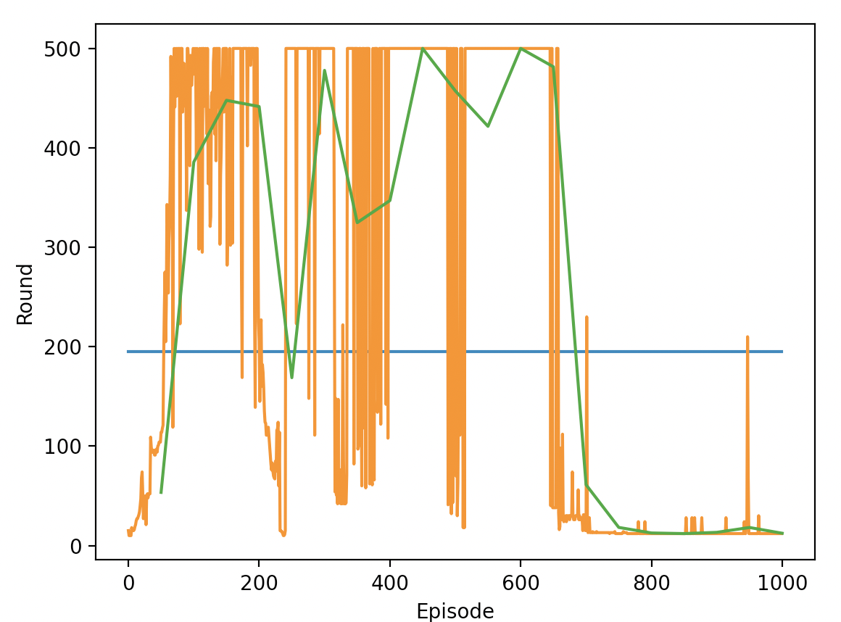
Hyperparameter: Greedy Epsilon
Epsilon decay: 5e-3 (Good)
Epsilon decay: 0.05 (Bad)

Slide 14
Hyperparameter: Batch Size and Memory Capacity
Batch Size Performance
1 | Acceptable
20 | Good
50 | Good
500 | Acceptable
1000 | Acceptable

Slide 15
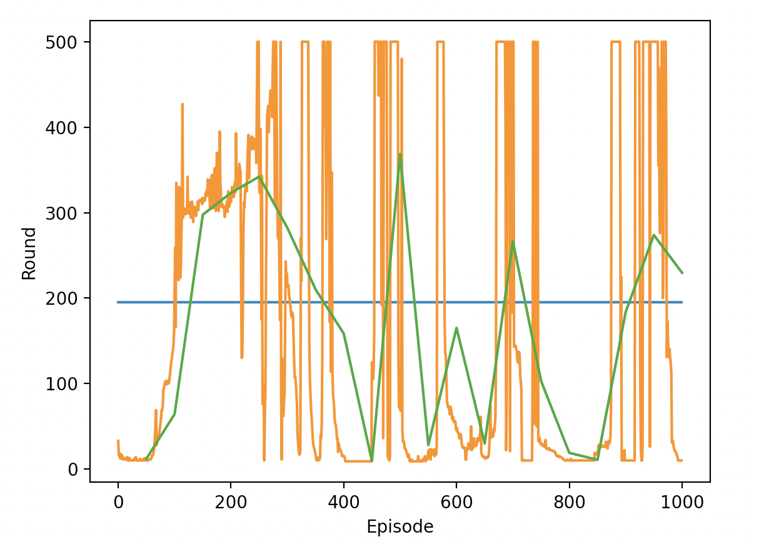
Hyperparameter: Batch Size and Memory Capacity
Batch size: 50 (Good)
Batch size: 500 (Acceptable)

Slide 16
Hyperparameter: Batch Size and Memory Capacity
Memory Capacity Performance
300 | Acceptable
3000 | Good
6000 | Acceptable

Slide 17
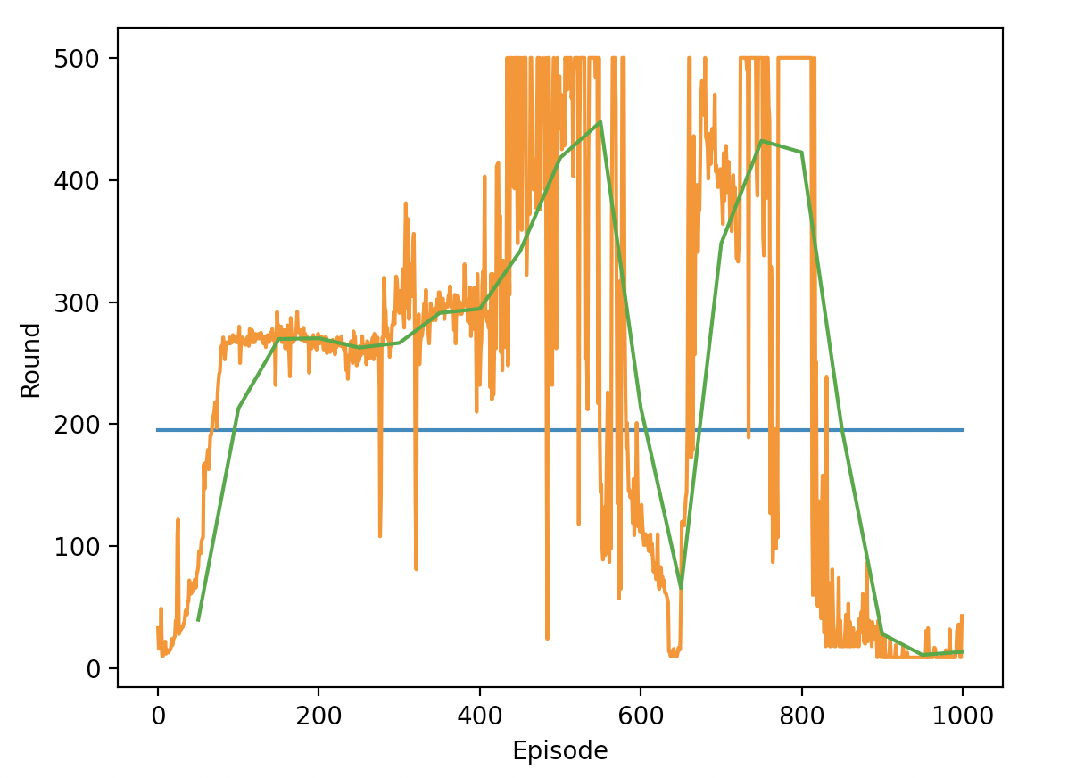
Hyperparameter: Batch Size and Memory Capacity
Memory capacity: 3000 (Good)
Memory capacity: 6000 (Acceptable)

Slide 18
Hyperparameter: Reward
Reward
Default reward | Use the environment default reward (1 at all the time)
Default reward with penalty | Reward 1 as the game runs, and get minus penalty when fail.
Success reward with penalty | Gain huge reward when it reach the maximum step
Increasing reward with penalty | Increase the reward as the game runs
Bad
OK
OK
Good

Slide 19
Hyperparameter: Target net updating term
Term Performance
1 | Good
10 | Good
20 | Good
30 | Good
40 | Bad

Slide 20
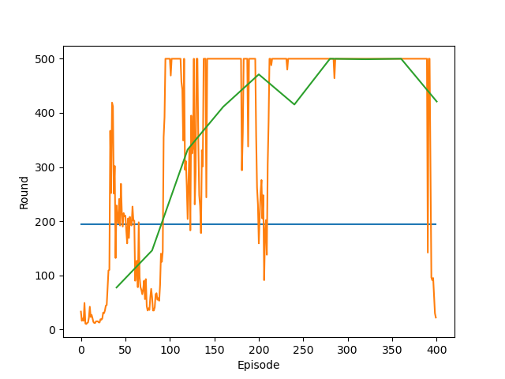
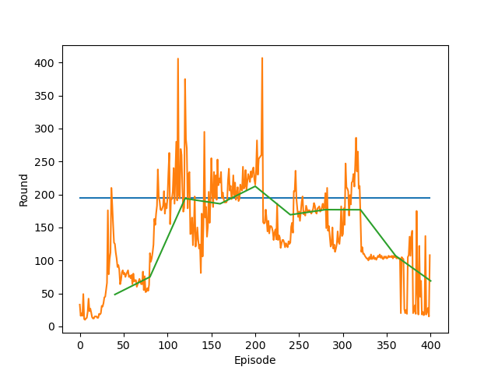
Hyperparameter: Target net updating term
Updating term: 30 (Good)
Updating term: 40 (Bad)

Slide 21
Hyperparameter: Learning Rate
Learning rate Performance
0.0001 | Acceptable
0.001 | Good
0.01 | Good
0.1 | Acceptable
1 | Bad

Slide 22
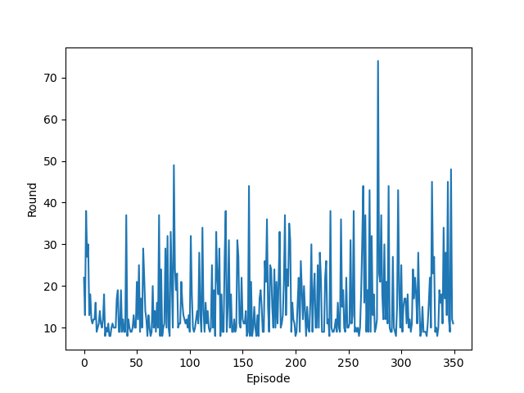
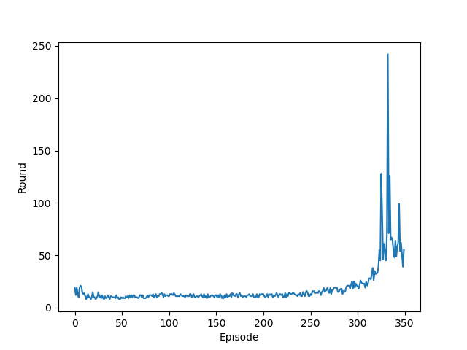
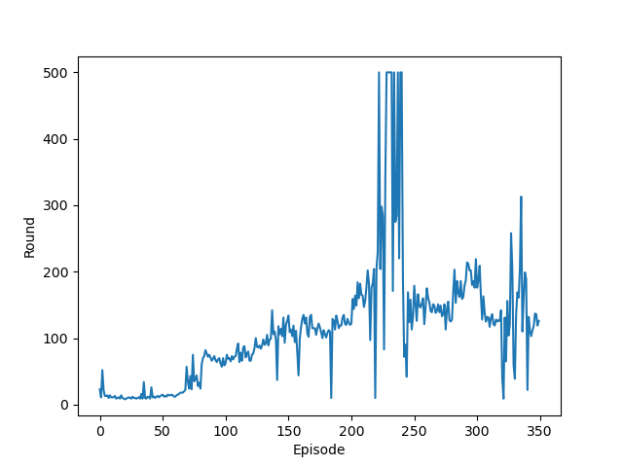
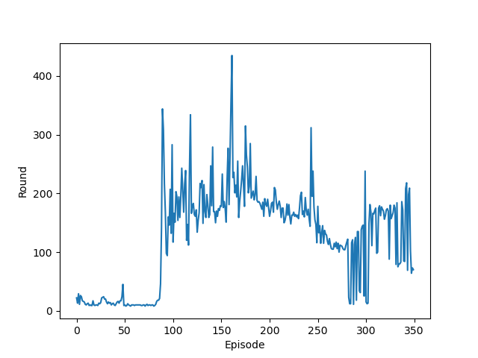
Hyperparameter: Learning rate
lr = 1 (bad)
lr = 0.0001 (acceptable)
lr = 0.01 (good)
lr = 0.001 (good)

Slide 23
Hyperparameter: Gamma
Gamma Performance
1.1 | Bad
0.999 | Good
0.99 | Good
0.9 | Good
0.75 | Good
0.3 | Bad

Slide 24
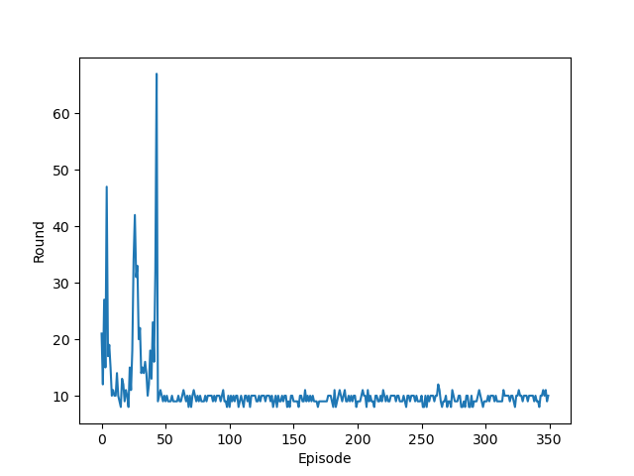
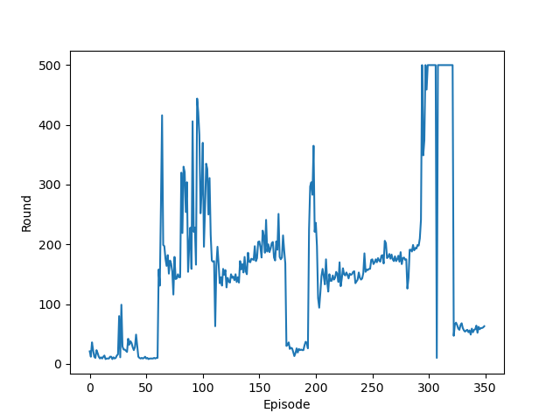
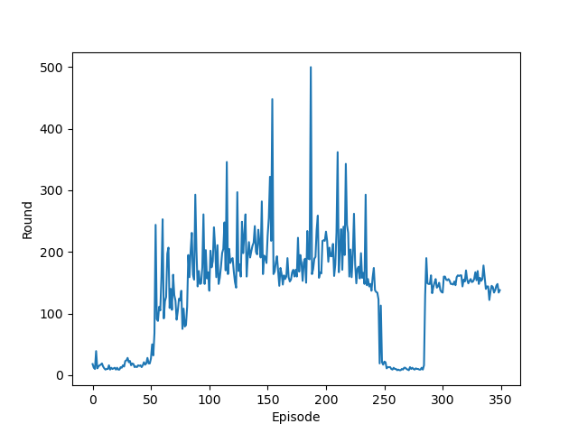
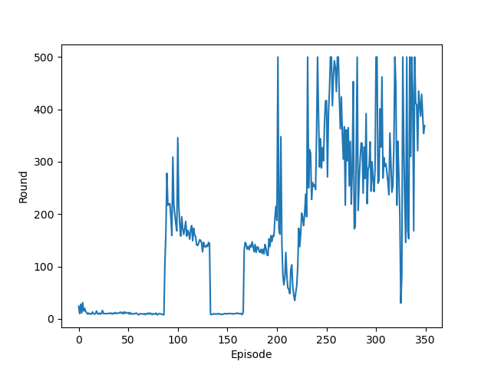
Hyperparameter: Gamma
gamma = 0.3 (bad)
gamma = 1.1 (bad)
gamma = 0.99 (good)
gamma = 0.75 (good)

Slide 25
Hyperparameter: Optimizer
Optimizer Performance
Adam | Good
Adagrad | Bad
SGD | Bad
RMSProp | OK

Slide 26
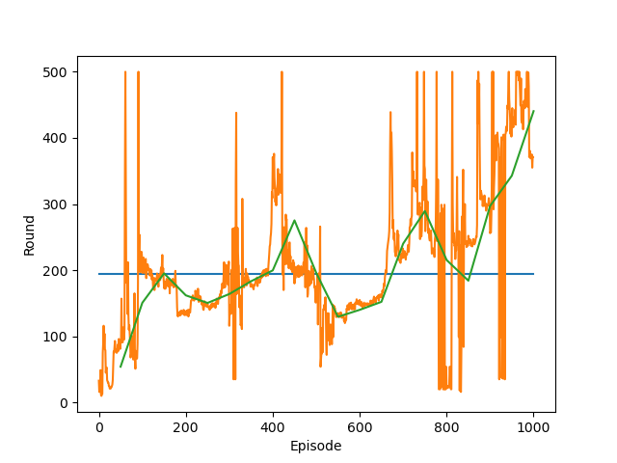
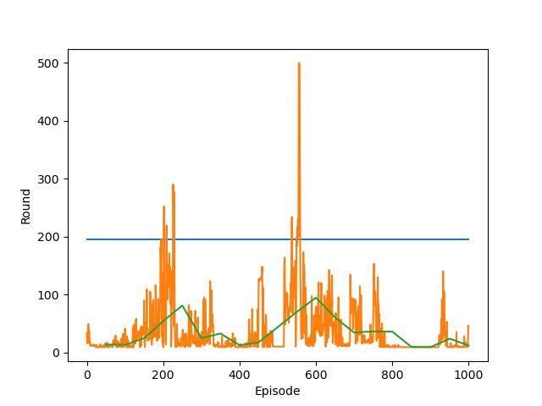
Hyperparameter: Optimizer
RMSProp
SGD

Slide 27
Hyperparameter: Neural Network
Models Performance
Dense Hid = 30 | Acceptable
3-layer Hid = 80 | Good
3-layer Hid = 30 | Acceptable
4-layer Hid = 30 | Acceptable

Slide 28
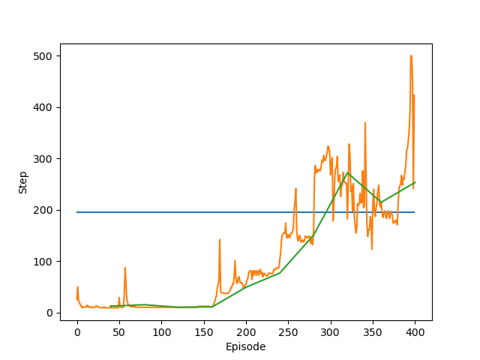
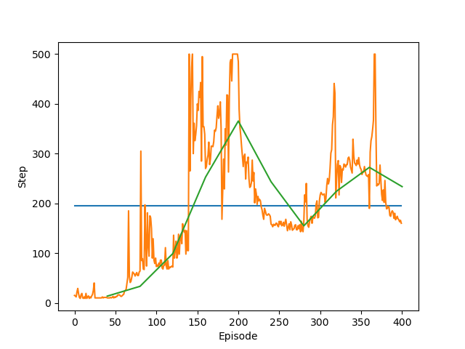
Hyperparameter: Neural Network
Dense network with 30 hidden unit
3-layer Fully connected network with 80 hidden unit

Slide 29
Hyperparameter: Loss Function
Loss function Performance
MSE Loss | Good
Cross Entropy | Bad
L1 Loss | Bad
Huber Loss | Bad

Slide 30
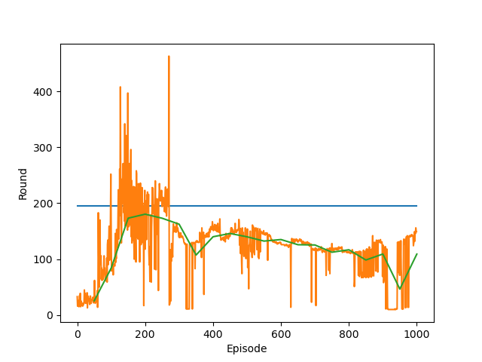
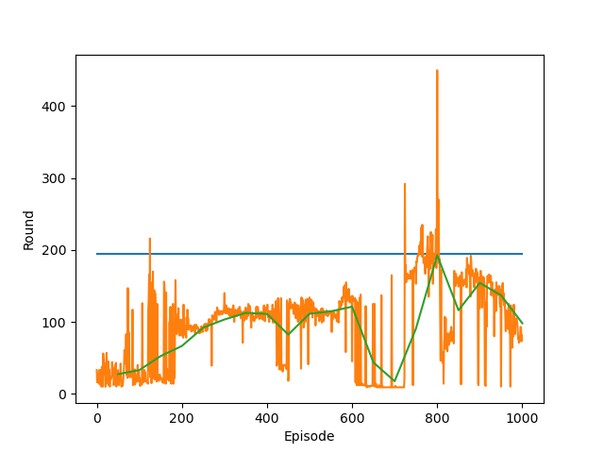
Hyperparameter: Loss Function
Huber Loss
L1 Loss

Slide 31
Results
01
02
The reward & average
reward
Compare DQN with DDQN
we provide other RL methods to see the differences.
Improvement was not significant.
Successful training
Other
03
04
An average duration of over 195 would be considered a training success.
Increasing the number of hidden units and the number of layers can speed up the learning process.
Cartpole game

Slide 32
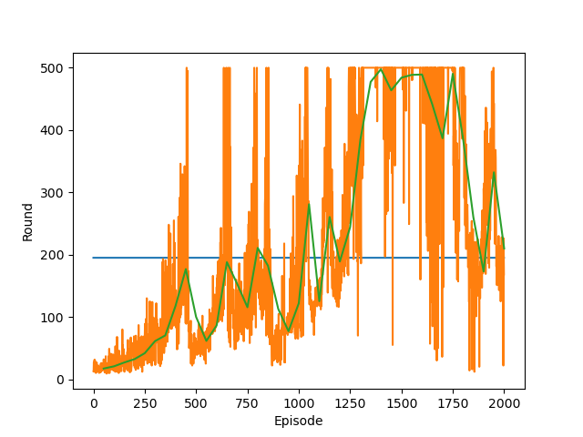
Results
Reinforce

Slide 33
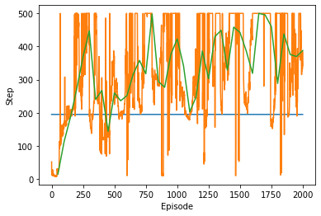
Results
DDQN

Slide 34
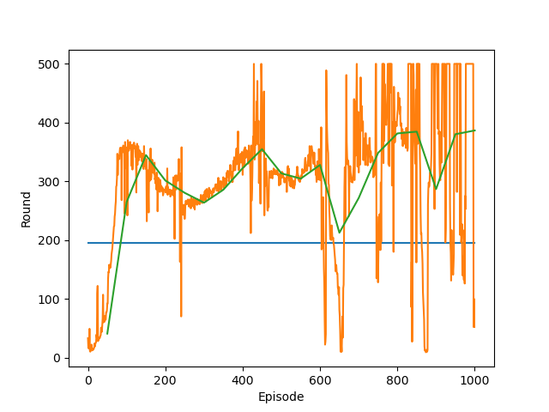
Results
DQN

Slide 35
Conclusion
REINFORCE
01
Takes the longest time to be trained.
02
DQN
Can reach our threshold in much shorter time.
DDQN
DQN and Double DQN agents have similar performance.
03
By fine tuning, DDQN can outperform
DQN.
04
Possible improvements
Can discuss how to make the algorithm converge.

